Slide 1
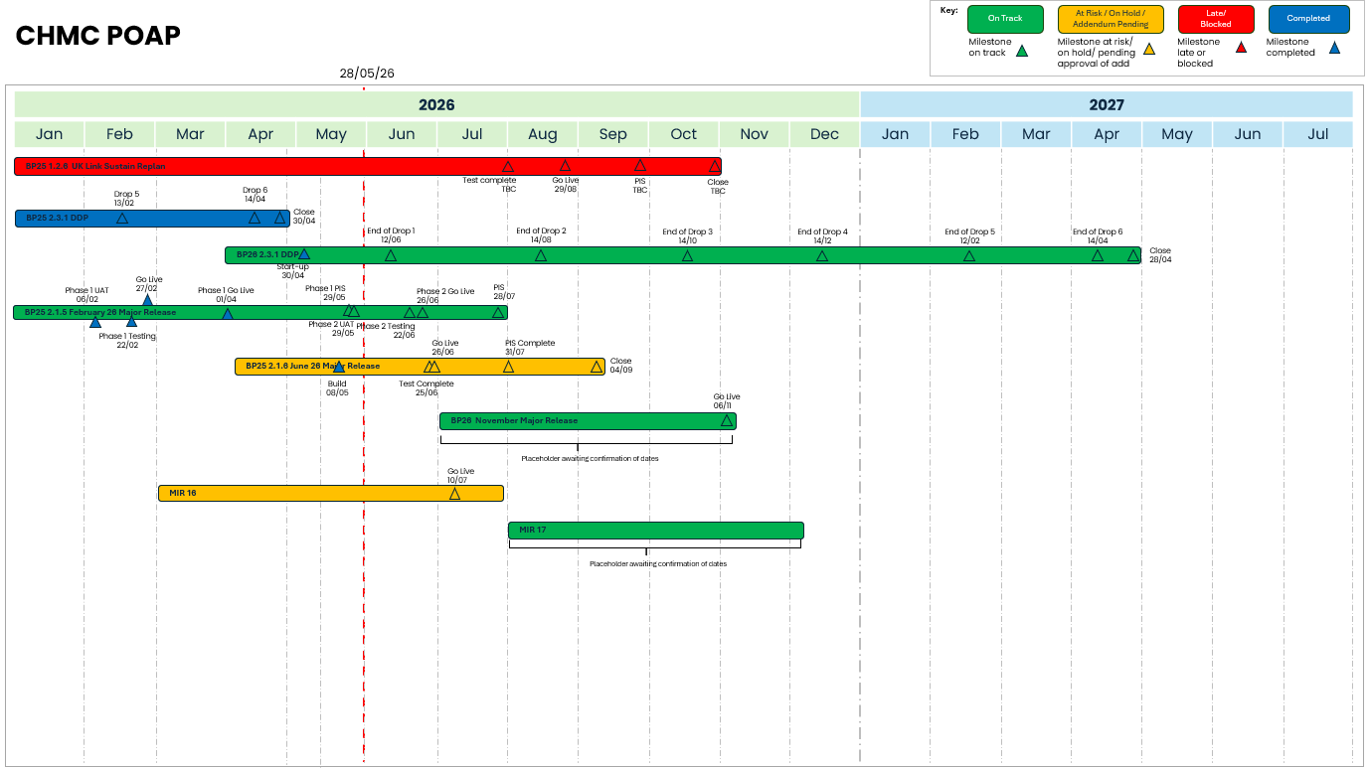
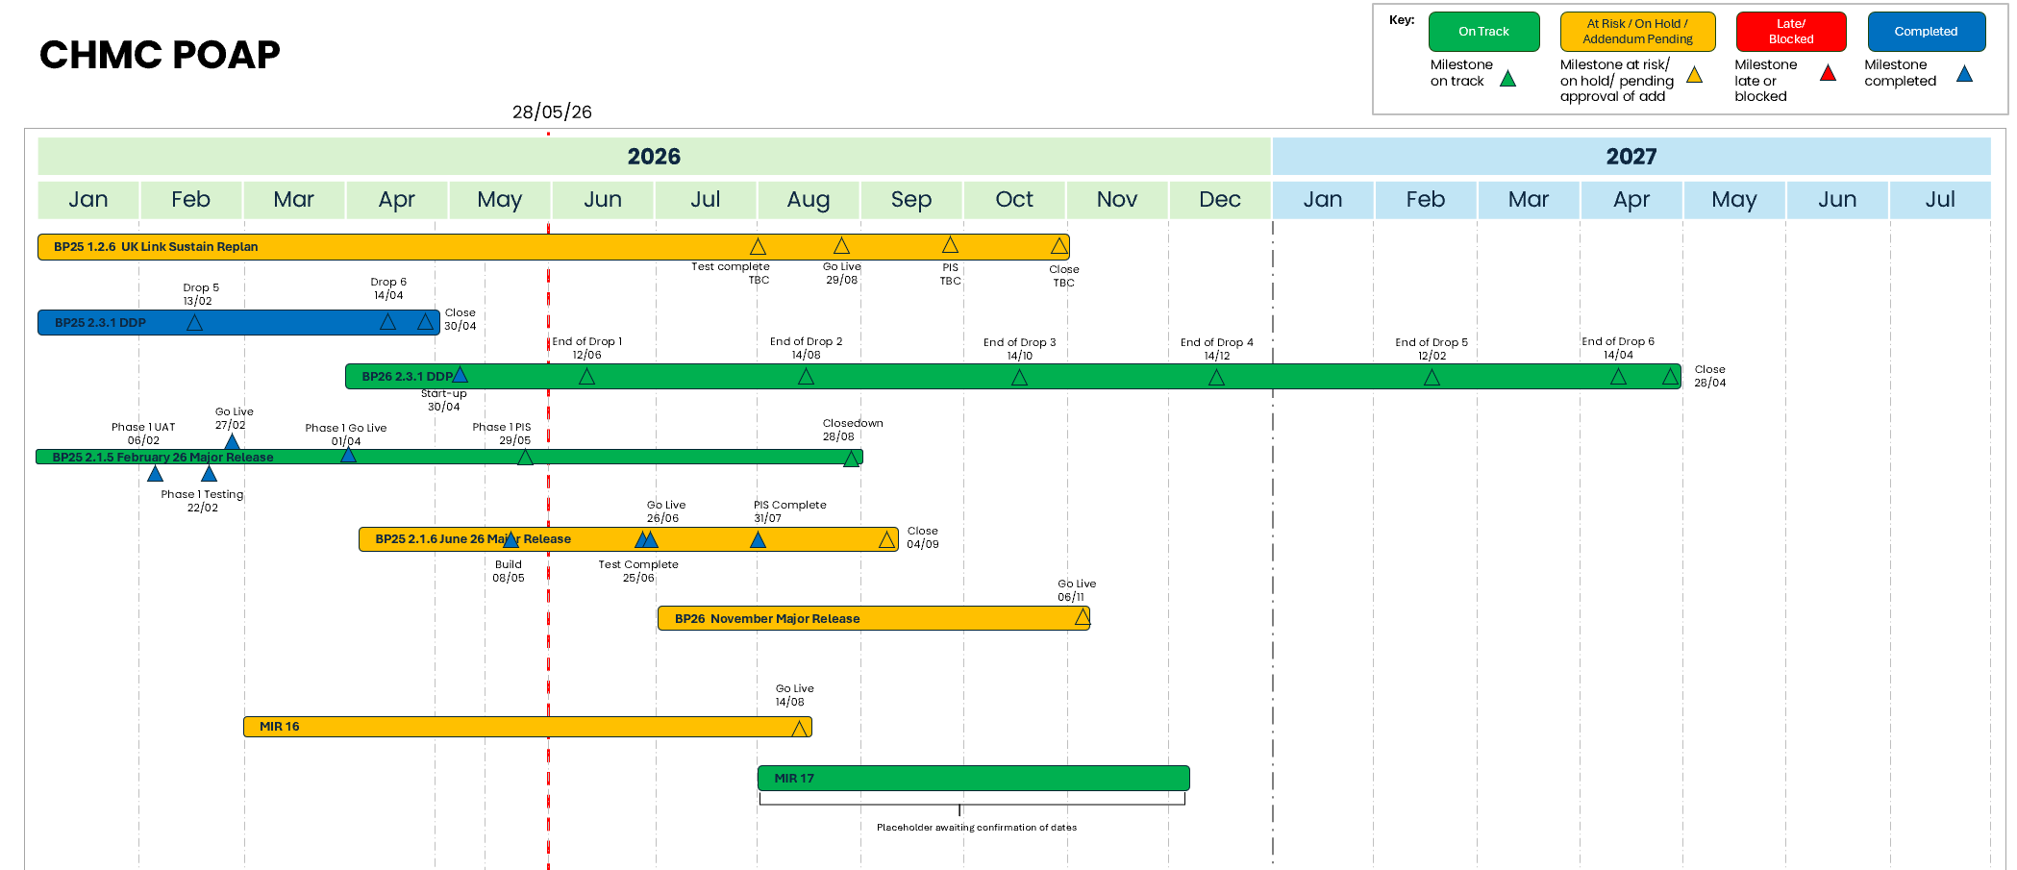
Portfolio Plan On a Page
© Xoserve
Notes:
Add bullets

