Slide 1
Unidentified Gas (UIG)

Slide 2
Summary
What is Unidentified Gas (UIG)
The majority of gas consumed in Great Britain can be accounted for as it is metered and registered. However, some gas is lost from the system, or not registered, due to theft, leakage from gas pipes, consumption by unregistered supply points and other reasons.
The gas that is off taken from the Local Distribution Zone (LDZ) System, but not attributed to an individual Supply Meter Point or accounted for as Shrinkage, is referred to as UIG.
Why is UIG such a hot topic?
The level of UIG can be volatile on a day to day basis, with calculated UIG values being unpredictable in nature.
The lack of projected UIG values is financially impacting organisations within the industry and customers are looking to Xoserve for further support and knowledge.
4

Slide 3
How is UIG calculated?
5

Slide 4
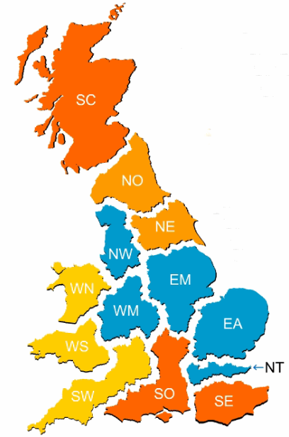




What are the UIG Contributors & Calculations?
To calculate the Unidentified Gas there are several considerations
  Each LDZ is calculated independently of each other and is calculated on a daily basis.
  The input to each LDZ is from the NTS. This is known as Total LDZ Energy.
  Outputs are primarily what is consumed at supply points. These are broken down as Total DM Energy and Total NDM Energy.
  Gas can also be lost as part of the gas transportation activities, theft or leakage. Some of this is accounted for as Shrinkage and is also an output .
At a high level, the daily calculation for Unidentified Gas (UIG) for each LDZ is:
UIG = Known inputs – Known outputs
6

Slide 5
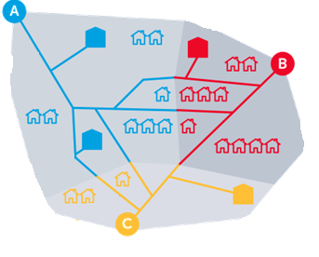
What is Total LDZ Energy?
Input
Total LDZ energy is all of the energy entering an LDZ from the NTS.
LDZs usually have multiple gas input points, as shown in the diagram opposite
To provide the daily LDZ energy and display it in Gemini, National Grid collect readings from the measurement device at each input point. Using an aggregator tool they convert this to a total LDZ before publishing.
Net gas moved to/from storage and any net stock change within the LDZ also contribute to the Inputs to make up Total LDZ Energy.
For more information on offtake equipment see
https://www.gasgovernance.co.uk/index.php/MER
7

Slide 6

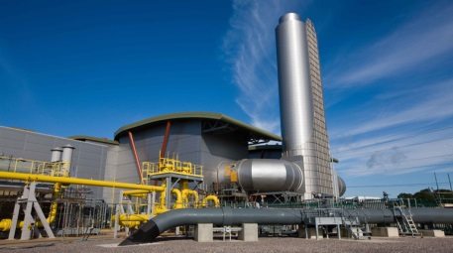

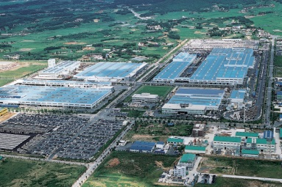
What makes up Total DM Energy?
Output
DM Energy is the total energy for Class 1 & 2 sites. Reads received from Shippers and Daily Metered Service Provider's (DMSP class 1 only) are used to calculate energy in Gemini and are simply added up to provide a Total DM Energy.
+
+
= Total DM Energy
The accuracy of the DM figure relies on timely receipt of accurate data. With only a very small number of sites making up nearly 20% of the allocation, any inaccurate reads received could have a large impact on UIG.
8

Slide 7
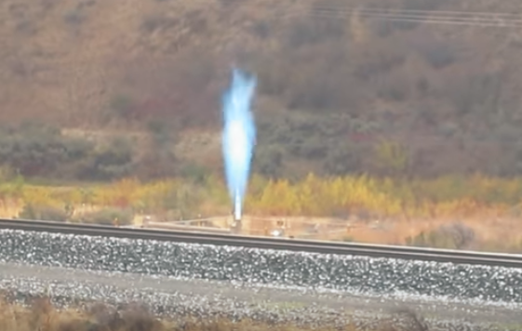

What is Shrinkage?
Output
Within each LDZ there is some expected losses of gas from the network. This is known as Shrinkage.
It is made up of three factors and is calculated by the Network Operators supported by the Industry Shrinkage Forum, these are:
  Leakage, with individual quantities being calculated at LDZ level
  Own Use Gas (used by the Transporters for transportation activities). This is a single factor applied across all LDZs
  Theft of Gas, which is gas stolen upstream of the meter with a single factor being applied across all LDZs.
For more information on Shrinkage please refer to the following documents;
LDZ Shrinkage Adjustment Methodology
2018-19 Shrinkage Final Proposals
10

Slide 8
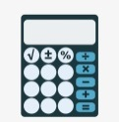
How is UIG then calculated?
Now we are able to identify the majority of the energy passing through the LDZs we are left with a small % that is unidentified. The final calculation is:
UIG = Total LDZ Energy – DM Energy - NDM Energy – Shrinkage
UIG
Non-Daily Metered (NDM) Energy
This is calculated on a daily basis and is reported against a UIG meter in Gemini.
UIG is calculated per LDZ and then this allocated based on Class and EUC category.
Total LDZ Energy
Daily Metered (DM) Energy
LDZ Shrinkage
11

Slide 9
How can I help mitigate the impacts of UIG?
12

Slide 10
How to mitigate impact on UIG
  UIG calculations relies on accurate and up to date information. This not only assists in the accurate allocation of energy for this sector, but also having the most up to date information helps to reduce a greater impact at reconciliation. The entire industry can mitigate these impacts by working together and …
Review accuracy of AQs and complete adjustments where required
Promptly registering Shipperless/unregistered sites
Supplying regular accurate reads, in line with read frequency, for NDM meter points
Timely notification of meter asset exchanges/updates
Using the Class 2 product for larger NDM LSP sites where appropriate and submit daily reads
Support NDM Demand Estimation modelling by enhancing sample data, especially for smaller LSP market
Continuing to be diligent in managing consumer theft of gas
Correct Domestic or Industrial & Commercial flag used
Ensure timely resolution of requests to Xoserve
Managing changes and defects to support activities feeding into UIG.
Supply accurate DM Nominations as early as possible each day
Timely notification of meter asset exchanges/updates
Support site set-up investigations, including timely site visits
Continuing to be diligent in managing consumer theft of gas
Gas Transporters continue to review accuracy of LDZ offtake equipment to minimize errors
13

Slide 11
How are UIG charges shared out?
14

Slide 12
How UIG is shared out?
Due to the changes in gas settlement Project Nexus brought about, the industry agreed there was a requirement to fairly apportion the total UIG between classes and End User Category (EUC).
To help with this, an independent expert (AUG Expert) helped the industry develop a methodology and provide a table of weighting factors that assigns the correct amount of UIG to different classes of meter points.
The table of weighting factors is used in the daily gas nomination and allocation processes.
Daily measured or estimated gas throughput in each LDZ is weighted using the AUG table factors to assign daily UIG to Shippers based on their throughput by meter point class and EUC.
For more information on the AUGE please refer to the following document
AUG Statement 2018/19
15

Slide 13
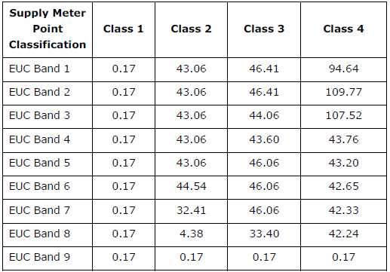
What is the Weighting Factors Table?
There are 36 Unidentified Gas Weighting Factors, which are made up of nine EUC bands by four Classes*.
The same factors apply to all Local Distribution Zones (LDZs)
The Weighting Factors are published on the Joint Office of Gas Transporters website for each year.
The total UIG for each LDZ, Class and EUC profile are weighted using a ratio calculation rather than a % calculation.
Table for 12 month period from 1st October 2018. (Gas year 18/19)
For information Weightings for each year please refer to the following document
https://www.gasgovernance.co.uk/augenex
16

Slide 14
UIG Calculation & Allocation example
Worked example
At a high level we will look at how this all fits together. For this example we will assume 3 Shippers in one LDZ. All the values are representative of energy
Step 1 - Calculate total LDZ Energy
Step 2 - Calculate throughput for each Shipper
Step 3 - Calculate throughput for Total LDZ Energy
Step 4 - Apply weighting factors* to all Shipper throughput
Step 5 - Apply weighting factors* to Total LDZ Energy and total all weightings
Step 6 – Calculate weighted shipper throughput as a percentage
Step 7 - Apportion UIG.
* Weighting table used is example only and not reflective of any true data
17

Slide 15
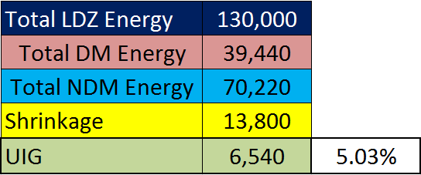
UIG Calculation & Allocation example
Worked example
UIG = Total LDZ Energy – DM Energy - NDM Energy – Shrinkage
Step 1 - The UIG for the LDZ is calculated using the above calculation. Which in the example equates to 6540 or 5.03% of the total.
Step 2 Calculate the throughput of a shipper (in the example we have titled Shipper A). The throughput is calculated by EUC and class.
Shipper A has a large domestic Portfolio with few Large Supply points & DM sites.
18

Slide 16
UIG Calculation & Allocation example
Worked example
Step 3 We calculate the Total LDZ throughput in the same way .
Step 4 Apply the weighting Factor table to the throughputs. The weighted throughput is calculated for each shipper.
Each Shipper is calculated independently of each other.
19

Slide 17
UIG Calculation & Allocation example
Worked example
Step 5 Apply weighting factors to Total LDZ Energy.
Once the weighting throughput for Total LDZ has been calculated this is totalled the provide a Total LDZ Weighted Value.
20

Slide 18
UIG Calculation & Allocation example
Worked example
Step 6 The weighted value in each ‘cell’ (Step 4), is divided by the Total LDZ Weighted Value (Step 5) to provide what % share of the total UIG will be applied.
Step 7 The % share (Step 6) is multiplied to the total UIG to provide the amount of UIG apportioned to each EUC Band and Class. This can be totalled to give the total UIG for the Shipper which is shown in Gemini.
21

Slide 19
Where do I see the UIG charges?
22

Slide 20
Energy Balancing & Cashout for UIG
Energy Balancing is performed daily to ensure all inputs and outputs from the network are equal and accounted for.
At a high level Pre Nexus energy was balanced using the following factors.
At a high level Post Nexus energy is balanced using the following factors.
Trade sells
Trade sells
Trade Buys
Trade Buys
Total DM Energy
Total DM Energy
Storage withdrawal
Storage withdrawal
Storage Injection
Storage Injection
Input from Terminals
Input from Terminals
Total NDM Energy
UIG
Total NDM Energy
Inputs
Outputs
Inputs
Outputs
As you can see the main difference is that UIG now appears on the outputs side although the UIG and Total NDM Energy post nexus equates to the Total NDM Energy pre nexus.
23

Slide 21

Considerations for UIG as Part of EB & Cashout
As UIG now forms part of a Shipper’s overall daily cash out, it is part of the Daily Cashout charges on a Shipper’s Energy Balancing Invoice.
The UIG meter does not appear on the EBI invoice with its own charge type.
The Shipper’s overall daily imbalance is worked out using all input and trades acquired minus all outputs (DM sites, NDM sites, UIG) and trades sold which gives the overall imbalance for the gas day and Shipper.
If the value is positive then the Shipper has over delivered and they are cashed out at SMP sell price. If the value is negative, they have under delivered and this is cashed out at SMP buy price.
Final allocations are used for final imbalance and cash out.
UIG is on the output side hence effectively closed out at D+5
24

Slide 22
How does reconciliation affect UIG?
25

Slide 23
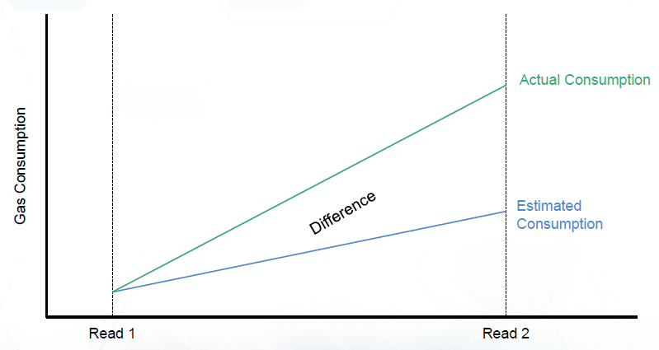
How does reconciliation affect UIG?
Reconciliation relies on actual meter reads being submitted. These reads could either account for (identify) more or less gas than was used in the original UIG calculation, based on the previous actual read.
Therefore each actual read on each site impacts UIG in some way. All these reconciliation values are aggregated by Class, EUC and LDZ. The kWh is also apportioned but is not used to recalculate the financial amount and is a notional value.
For more information on the Amendments Invoice please refer to
https://www.xoserve.com/wp-content/uploads/AmendmentsInvoice.pdf
26

Slide 24
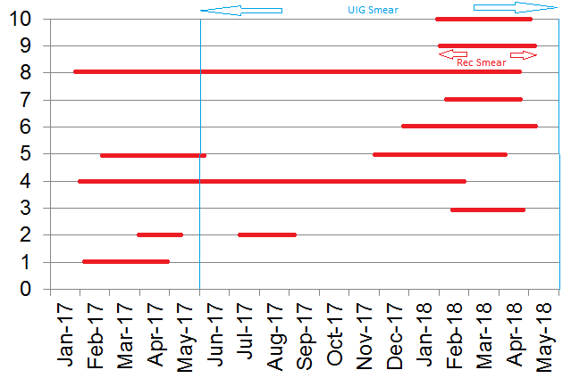

How does reconciliation affect UIG?
We perform reconciliation on all sites where we have received read(s) in that billing month.
The energy for each site is smeared across the reconciliation period (read date - read date) shown in red.
The opposite value amends UIG* energy (aggregated at LDZ, Class, EUC level) and is then smeared equally across the previous 12 months Impact of UIG smear shown in blue.
27

Slide 25
How to view UIG on the Amendments Invoices (AMS)
The Amendment Invoice (AMS) is triggered by a number of factors
There are 52 possible charges which can appear on the Amendment Invoice
One of the charge types is the UGR charge
The purpose of the UGR charge is to redistribute UIG throughout the network and across all Shipper networks proportionally to their portfolio
Invoice Files and Supporting Information Files
  AMS invoices are issued as a csv file via the IX on the 18th Business Day of each month
  Each AMS Invoice provides the UGR total charge per Network
  Shippers will receive separate invoices for each Network they operate in
  ASP Core Amendment Invoice Supporting Information file provides a further breakdown of the UGR charges across all Networks.
28

Slide 26
Where can I get more information on UIG?
.
29

Slide 27
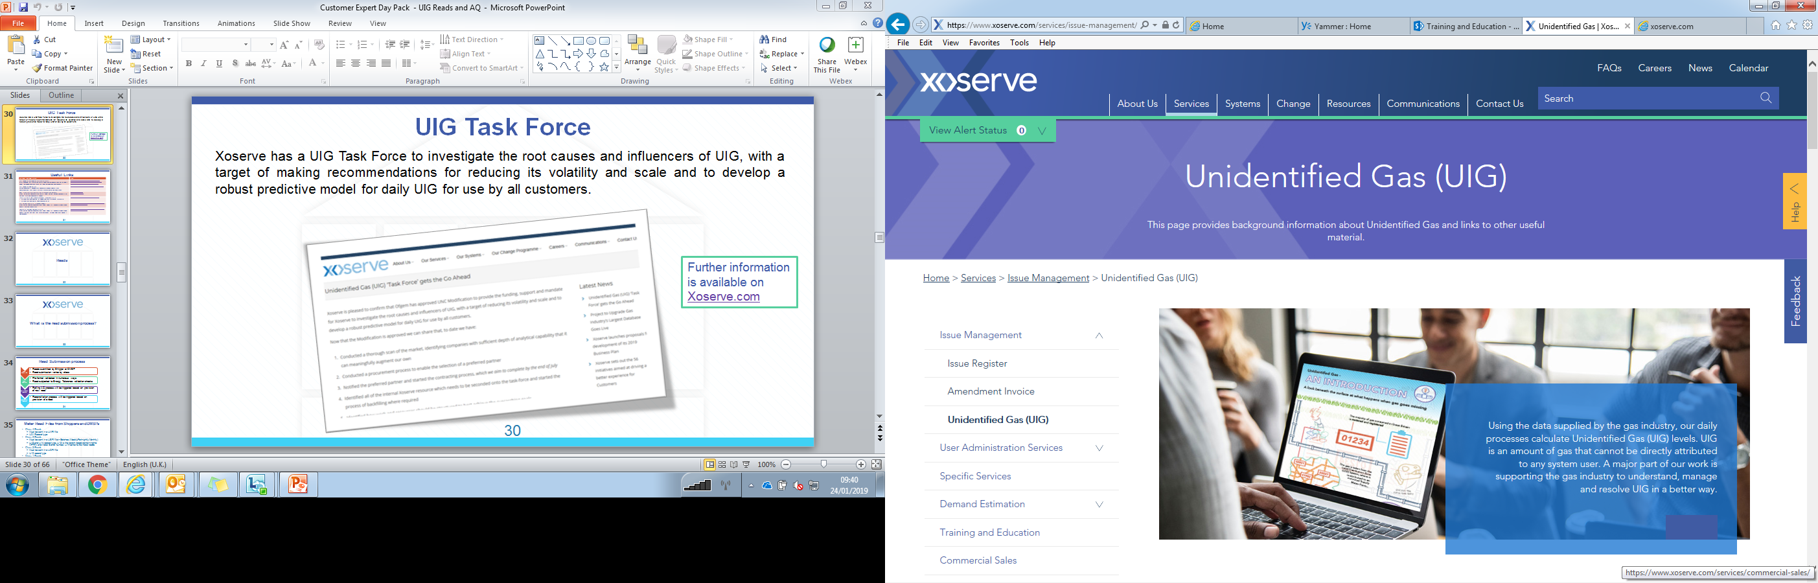
UIG Task Force
Xoserve has a UIG Task Force to investigate the root causes and influencers of UIG, with a target of making recommendations for reducing its volatility and scale and to develop a robust predictive model for daily UIG for use by all customers.
Further information is available on Xoserve.com
30

Slide 28
Useful Links
Document and description | Link
UIG pages on the Xoserve Information Library After launching the Information Library, select Q&A Categories from the title page > select the Unidentified Gas (UIG) tile > view the questions and answers. | https://www.xoserve.com/index.php/our-change-programme/uk-link-programme/uk-link-programme-workstream-updates/uk-link-information-library/
UIG pages on Xoserve.com Multiple documents, including UIG Resolution – Weekly Update, UIG Communications, UIG Events Material, UIG Information and Useful Links | https://www.xoserve.com/index.php/unidentified-gas-uig/
AML Supporting Information File Format and File Hierarchy From the UK Link Documentation Library, select UK Link Interface Documents > 3b. System Interface Documents > Shipper | Shipper File Formats Shipper File Hierarchies
Joint Office of Gas Transporters - AUG Statement 2018/19 28 June 2018 Final Allocation of Unidentified Gas Statement for 2018/19 28 June 2018 Final Factor Table Covering Letter | https://www.gasgovernance.co.uk/augenex/1819
UIG values (kWh & %) published weekly From UK Link Secured Documentation, select Folder 18 > Demand Estimation Project Nexus > LDZ Post-Nexus UIG | https://xoserve.sharepoint.com/sites/XEUKLINKDev/Pages/UserDocumentMgmt.aspx
Details of the NDM Demand Formula From UK Link Secured Documentation, select Folder 18 > Demand Estimation Project Nexus > current gas year (e.g. 2018-19 Gas Year) > 4. NDM Algorithms booklet > Section08_18 | https://xoserve.sharepoint.com/sites/XEUKLINKDev/Pages/UserDocumentMgmt.aspx
31

